Slide 1
1

Slide 2

APPLIED CRYPTOGRAPHY
Lecture 47
2

Slide 3
Digital signature RSA
Signature based on RSA algorithm
3

Slide 4
Contents
Mathematics for RSA
RSA key generation phase
Signing phase
Verification phase
Problems
Attacks

Slide 5
Math's for RSA
Euler's totient function
Fermat little theorem

Slide 6
Euler's totient function
Formulas for calculating φ(n)

Slide 7
Examples

Slide 8
Fermat little theorem
Two versions of the theorem.
1. If p is a prime and a is an integer such that p does not divide a,
then
2. If p is a prime and a is an integer, then
a^{p − 1} ≡ 1 mod p
a^{p} ≡ a mod p

Slide 9
Examples

Slide 10
RSA key generation phase
1. Select two prime numbers P and Q
2. Compute n=P*Q
3. Compute φ Euler's totient function.
Φ(n) = (p-1)(q-1)
4. Select e such that gcd(e, φ (n))=1
5. Determine ‘d’ as d*e = 1 mod φ (n)
Note:
Allice keeps “d” and publicly announces n and e.
In RSA digital signature scheme d is private; e and n are public

Slide 11

Signing phase
Alice creates a signature out of the message using her private exponent S = $M^{d}mod n$
Sends Signature S and Message M to bob

Slide 12
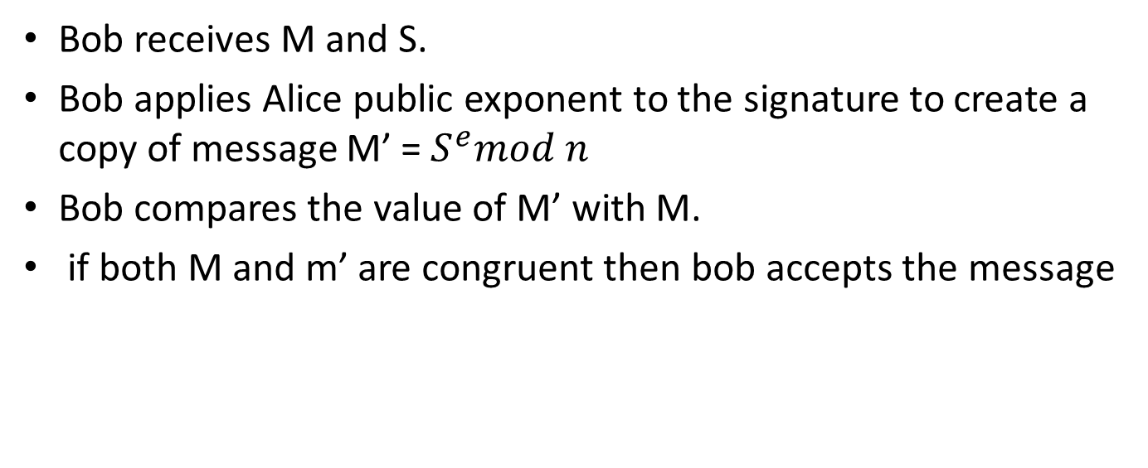
Verification phase
Bob receives M and S.
Bob applies Alice public exponent to the signature to create a copy of message M’ = $S^{e}mod n$
Bob compares the value of M’ with M.
if both M and m’ are congruent then bob accepts the message

Slide 13
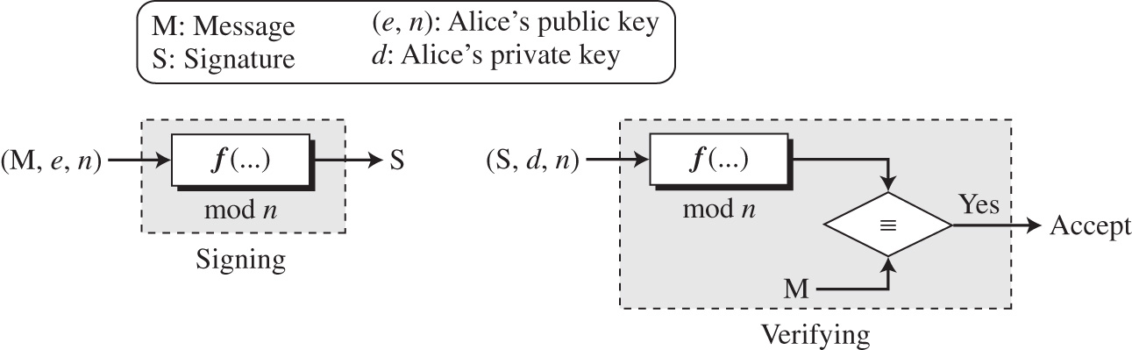

Slide 14
Attacks
Key only attack
Known message attack
Chosen message attack

Slide 15
Thank You!
Next Class
Mandatory reading for the next class
https://tools.ietf.org/html/rfc8017
15

Slide 16


Rajashree S
Computer Science and Engineering
PES University, Bengaluru
10 June 2020
16

